Slide 1
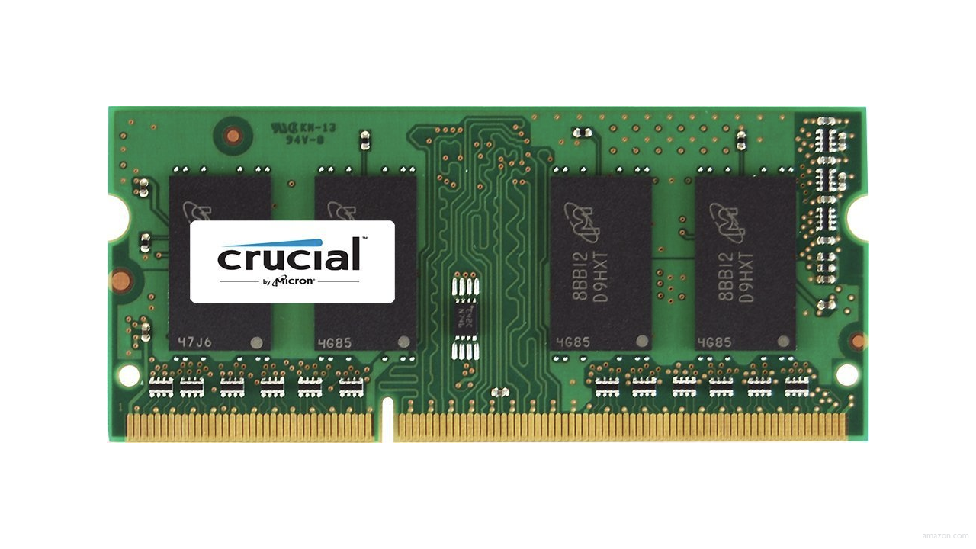

Slide 7
input →
→ output

Slide 8

→
→ output

Slide 9
→
→ bool

Slide 10
algorithms

Slide 11
linear search
Notes:
7 2 1 6 3 4 50

Slide 12
For i from 0 to n-1
If i'th element is 50
Return true
Return false

Slide 13
binary search
Notes:
3 4 6 7 50 82 91

Slide 14
If middle item is 50
Return true
Else if 50 < middle item
Search left half
Else if 50 > middle item
Search right half

Slide 15
If no items
If middle item is 50
Return true
Else if 50 < middle item
Search left half
Else if 50 > middle item
Search right half

Slide 16
If no items
Return false
If middle item is 50
Return true
Else if 50 < middle item
Search left half
Else if 50 > middle item
Search right half

Slide 17
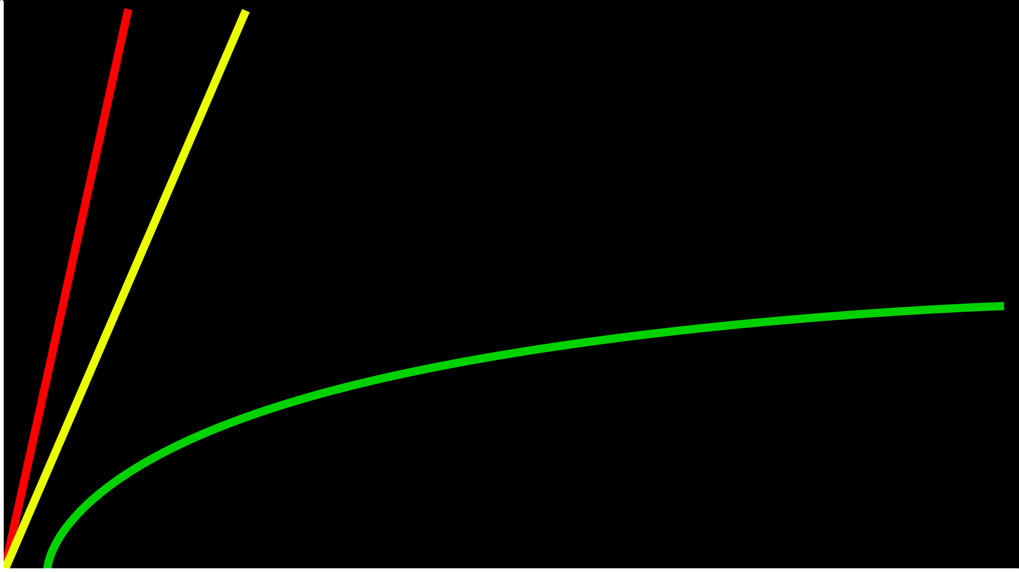
time to solve
size of problem

Slide 18
O(n)
O(n/2)
time to solve
O(log₂n)
size of problem

Slide 19
O

Slide 20
O(n)
O(n/2)
time to solve
O(log₂n)
size of problem

Slide 21
O(n)
O(n/2)
time to solve
O(log₂n)
size of problem

Slide 22
O(n)
O(n)
time to solve
O(log₂n)
size of problem

Slide 23
O(n)
O(n)
time to solve
O(log n)
size of problem

Slide 24
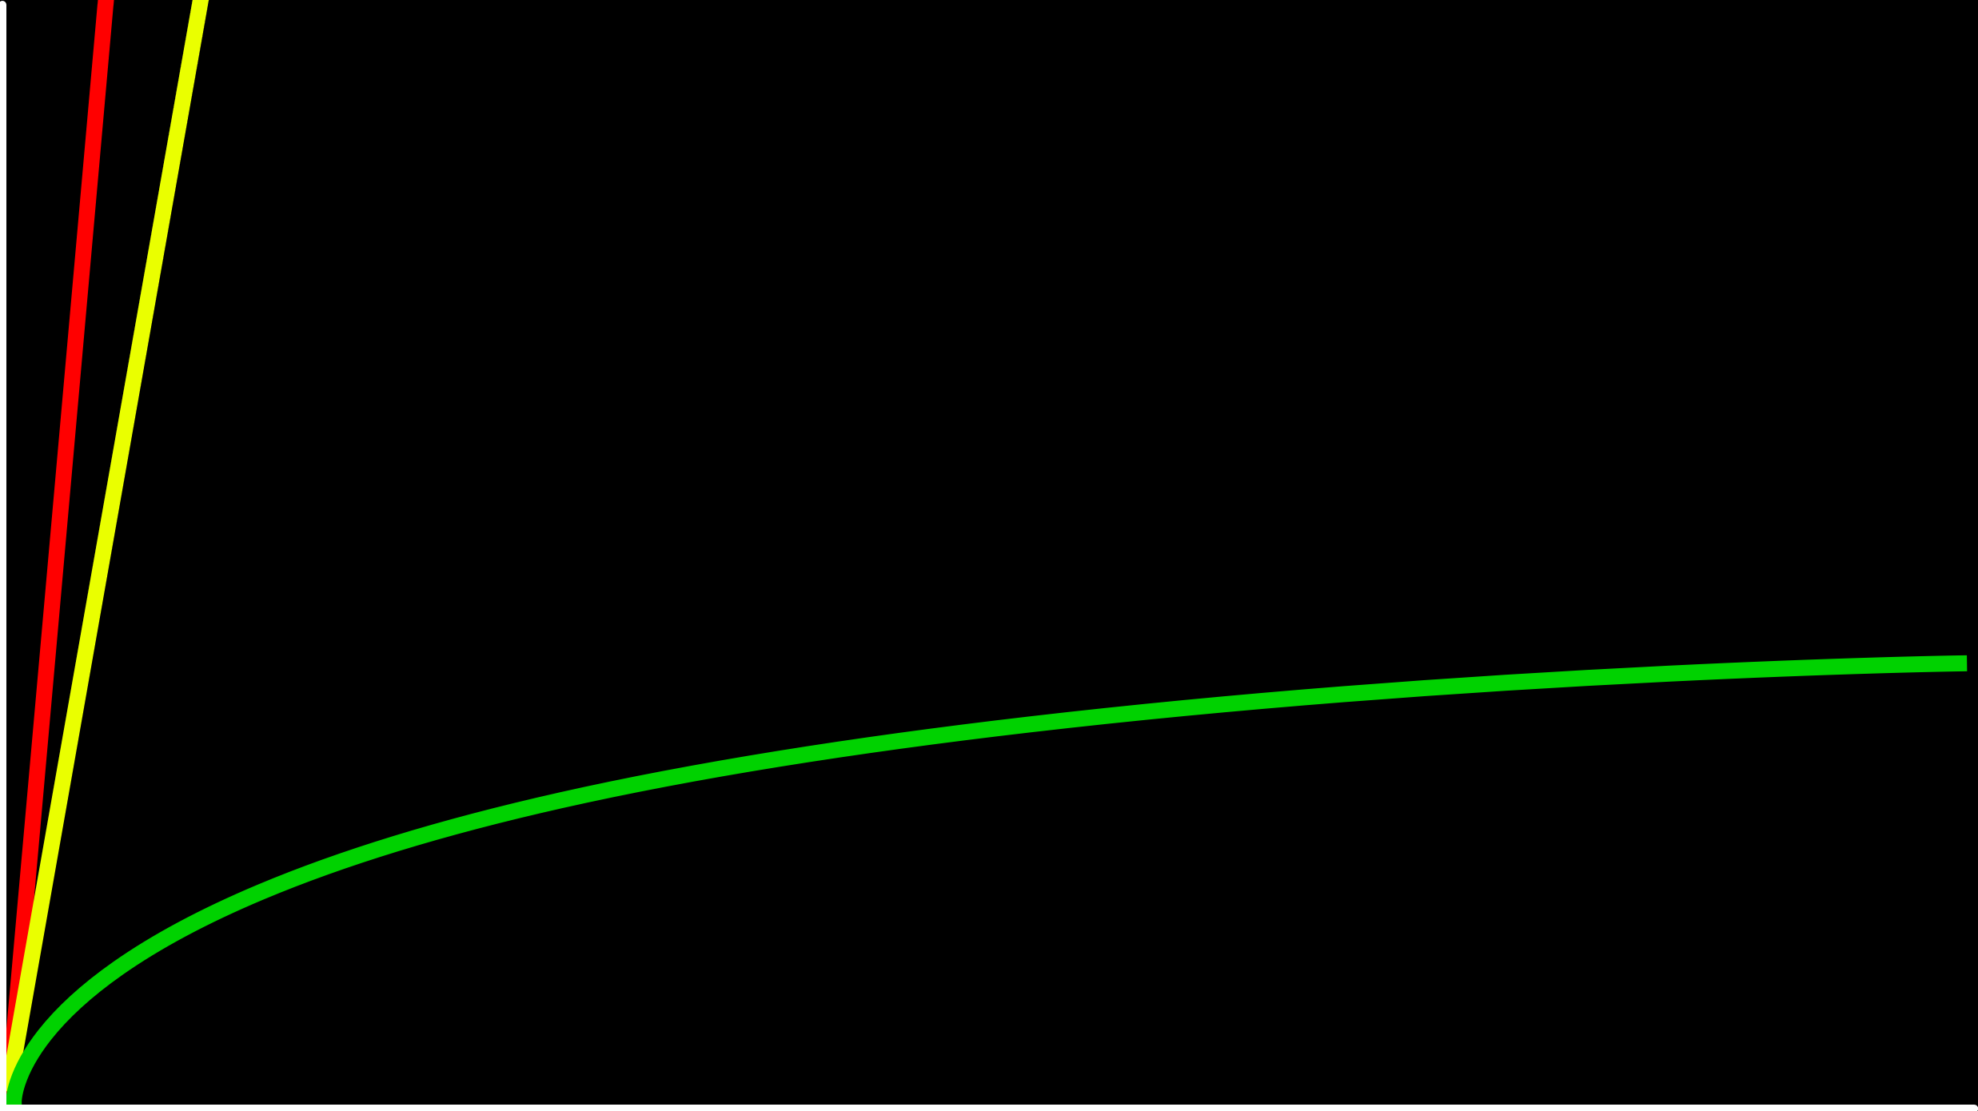
O(n)
time to solve
O(log n)
size of problem

Slide 25
O(n²)
O(n log n)
O(n)
O(log n)
O(1)

Slide 26
O(n²)
O(n log n)
O(n) linear search
O(log n)
O(1)

Slide 27
O(n²)
O(n log n)
O(n) linear search
O(log n) binary search
O(1)

Slide 28
Ω

Slide 29
Ω(n²)
Ω(n log n)
Ω(n)
Ω(log n)
Ω(1)

Slide 30
Ω(n²)
Ω(n log n)
Ω(n)
Ω(log n)
Ω(1) linear search

Slide 31
Ω(n²)
Ω(n log n)
Ω(n)
Ω(log n)
Ω(1) linear search, binary search

Slide 32
input →
→ output

Slide 33
unsorted →
→ output

Slide 34
unsorted →
→ sorted

Slide 35
→
→ sorted
7 2 1 6 3 4 50

Slide 36
→
→
7 2 1 6 3 4 50
1 2 3 4 6 7 50

Slide 37
6 3 8 5 2 7 4 1

Slide 38
recursion

Slide 39
1 Pick up phone book
2 Open to middle of phone book
3 Look at page
4 If Smith is on page
5 Call Mike
6 Else if Smith is earlier in book
7 Open to middle of left half of book
8 Go back to line 3
9 Else if Smith is later in book
10 Open to middle of right half of book
11 Go back to line 3
12 Else
13 Quit

Slide 40
1 Pick up phone book
2 Open to middle of phone book
3 Look at page
4 If Smith is on page
5 Call Mike
6 Else if Smith is earlier in book
7 Open to middle of left half of book
8 Go back to line 3
9 Else if Smith is later in book
10 Open to middle of right half of book
11 Go back to line 3
12 Else
13 Quit

Slide 41
1 Pick up phone book
2 Open to middle of phone book
3 Look at page
4 If Smith is on page
5 Call Mike
6 Else if Smith is earlier in book
7 Open to middle of left half of book
8
9 Else if Smith is later in book
10 Open to middle of right half of book
11
12 Else
13 Quit

Slide 42
1 Pick up phone book
2 Open to middle of phone book
3 Look at page
4 If Smith is on page
5 Call Mike
6 Else if Smith is earlier in book
7 Search left half of book
8
9 Else if Smith is later in book
10 Search right half of book
11
12 Else
13 Quit

Slide 43
1 Pick up phone book
2 Open to middle of phone book
3 Look at page
4 If Smith is on page
5 Call Mike
6 Else if Smith is earlier in book
7 Search left half of book
8
9 Else if Smith is later in book
10 Search right half of book
11
12 Else
13 Quit

Slide 44
1 Pick up phone book
2 Open to middle of phone book
3 Look at page
4 If Smith is on page
5 Call Mike
6 Else if Smith is earlier in book
7 Search left half of book
8 Else if Smith is later in book
9 Search right half of book
10 Else
11 Quit

